Slide 1

Al-Powered Ethical Decision Making Simulations with Mistral
Batch Roll No.s:
23B81A6781
23B81A6777
23B81A67A0
23B81A67B3
23B81A6779

Slide 2
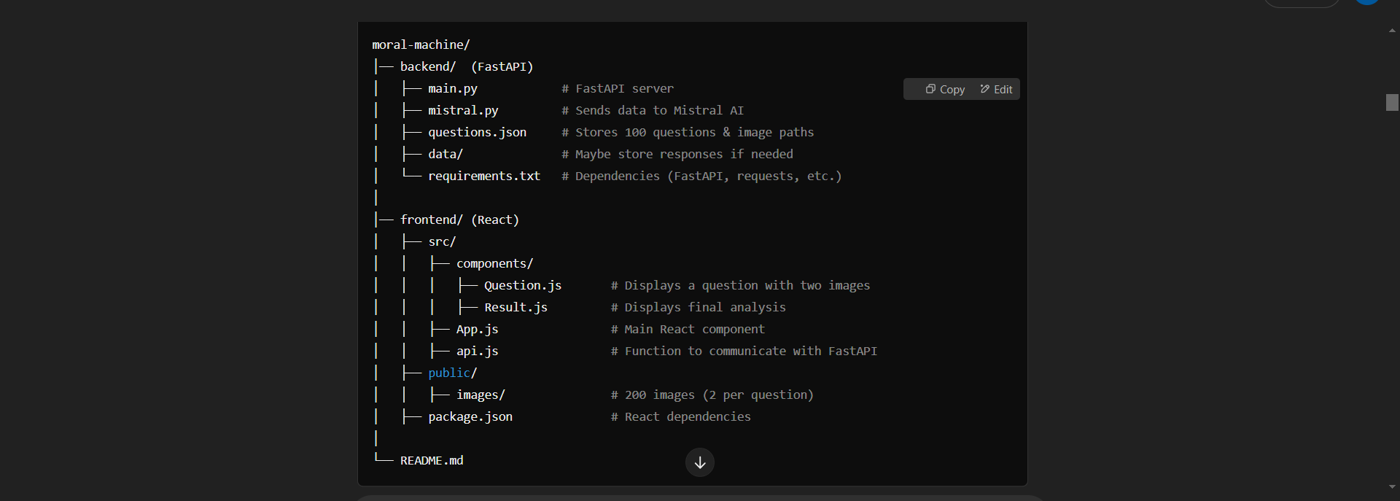
How our project will look like to us :

Slide 3
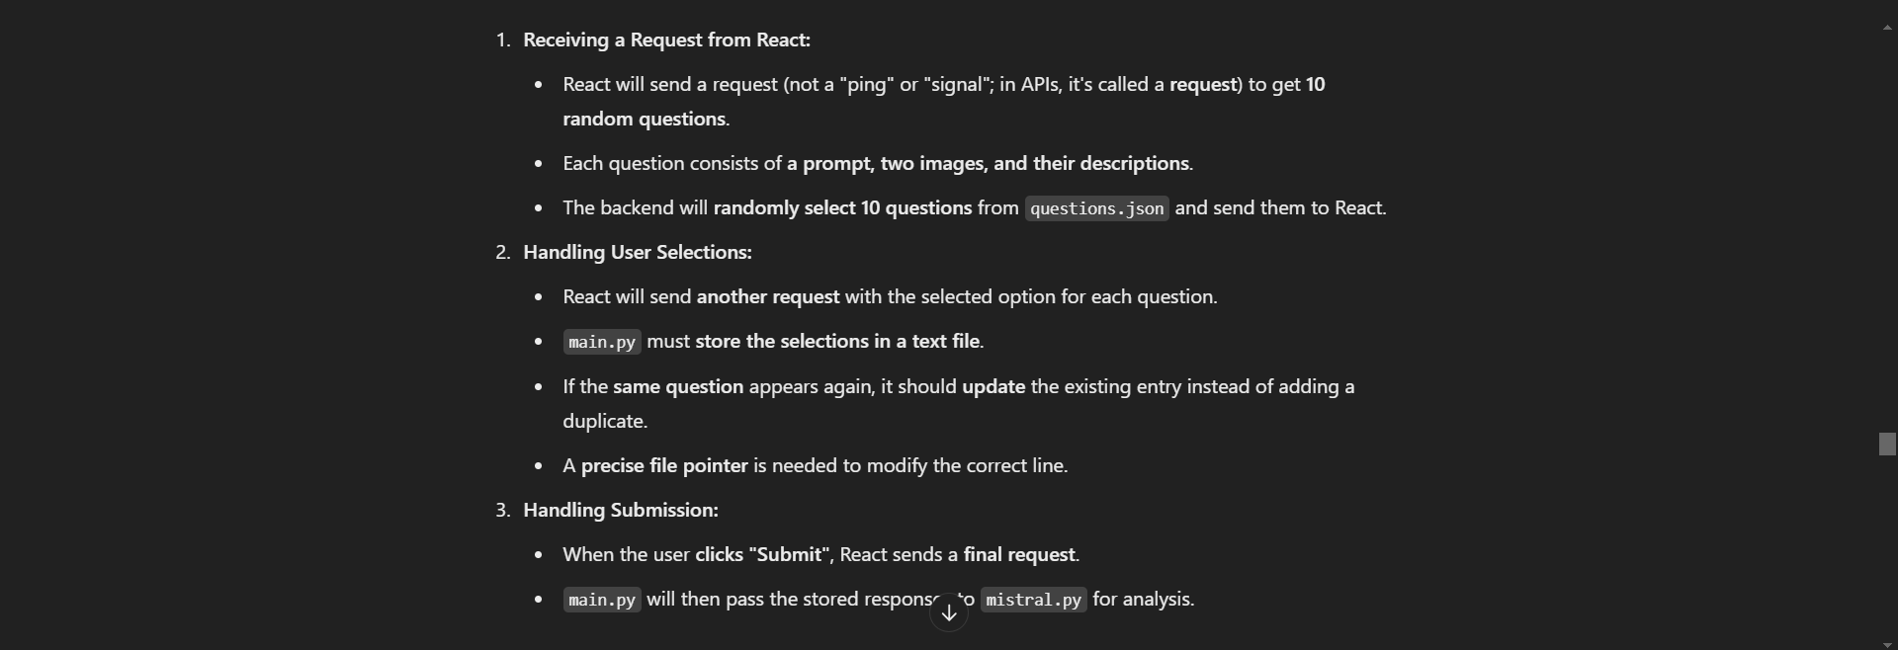
Task 1: Backend - main.py (FastAPI)

Slide 4

Task 2: Backend - mistral.py (Mistral AI Integration):

Slide 5
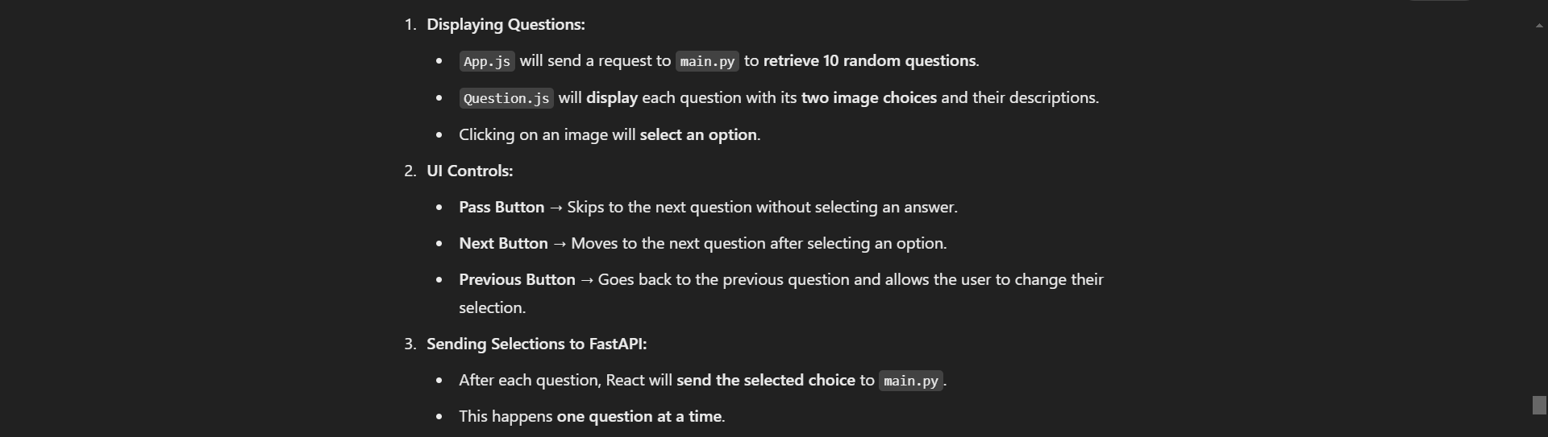

Task 3: Frontend (React)

Slide 6

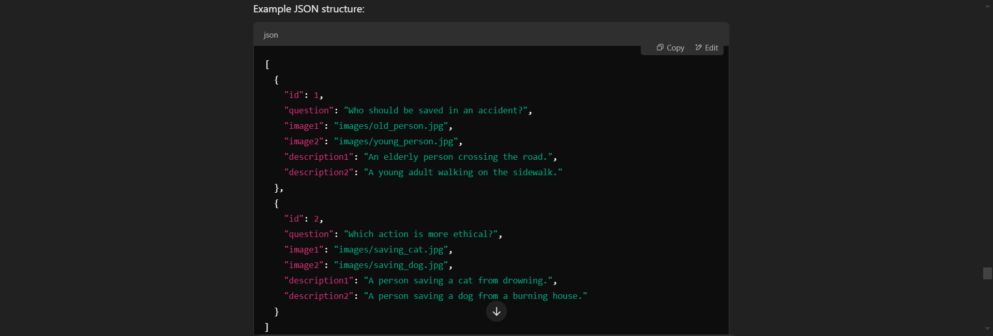
Task 4: JSON File (questions.json)

Slide 7

To get the questions and images :
1. find websites that post these questions or android apps
2. screenshot them-make question description
3. make sure they are good like related to i.e Ethical decision making””
4. 200 images , 2 as a pair with descriptions i.e : so, 100 questions , each 2 images , each image 2 descriptions

Slide 8

Task 5: Integration & Debugging
We will do this at the hackathon event time that is : putting everything together making changes debugging
ppt, video, etc ….

